Slide 1
AFFINITY ALGORITHM
CLUSTERING ALORITHMS

Slide 2
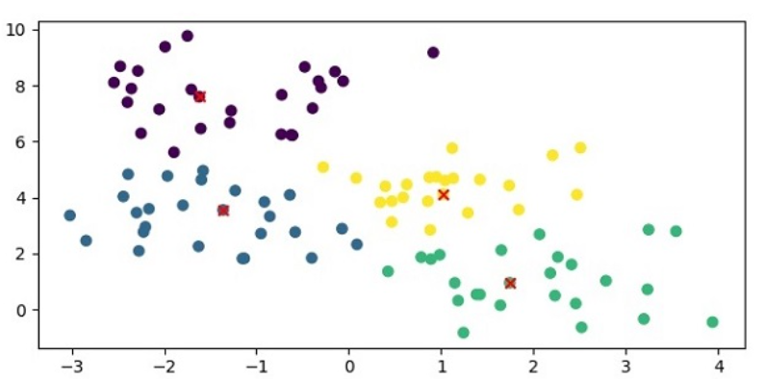
What is Affinity Propagation?
Definition: A clustering algorithm that identifies exemplars among data points and forms clusters based on message passing between points.
Key Features:
  Does not require the number of clusters to be specified in advance.
  Uses similarities between data points to determine cluster structure.
Key Concepts of Affinity Propagation
Exemplars: Data points that serve as representatives for clusters.
Message Passing: Two types of messages—responsibility and availability—are exchanged between points.
Input Similarity Matrix: Represents the similarity between pairs of data points

Slide 3
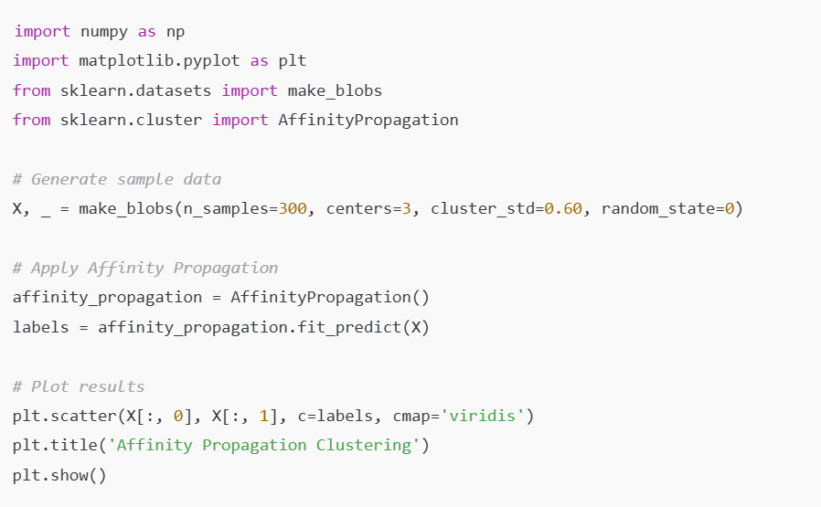
AFFINITY in scikit-learn
Examples:

